Slide 1
Final Parametric Analysis
Wedding Plan
Ge Bao
PRJM 524
May. 3rd 2021

Slide 2
Executive summary
The main project process contains parents meeting, engagement ceremony, and the final wedding ceremony
A planning part, a preparation part and an execution part for all 3 events.
The planning consists with me producing plans with the key stakeholders.
The preparation part is just me spending money on event items like alcohols and decorations.
The executions consist of me leading 16 helpers/drivers to carry out the plan on the event day.

Slide 3
Project background
Shanghai, China
A long, tiring, and complicated process
bride and groom are fully occupied with their own career
I am asked to plan and manage the process
Up till now, I have only conducted some general research and I, based on the research, only have a general understanding of the process, stakeholders, and their requirements.

Slide 4
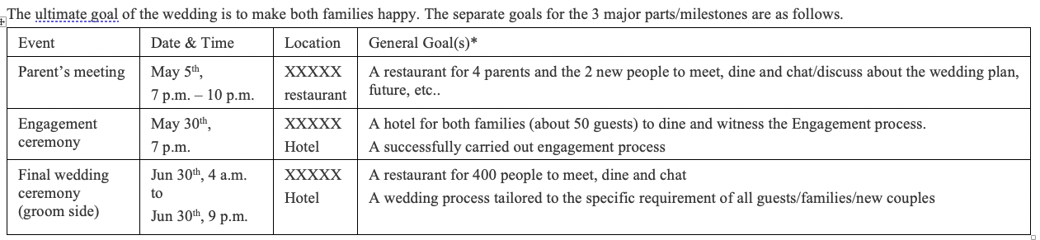
Project goals

Slide 5
Parameters

Slide 6
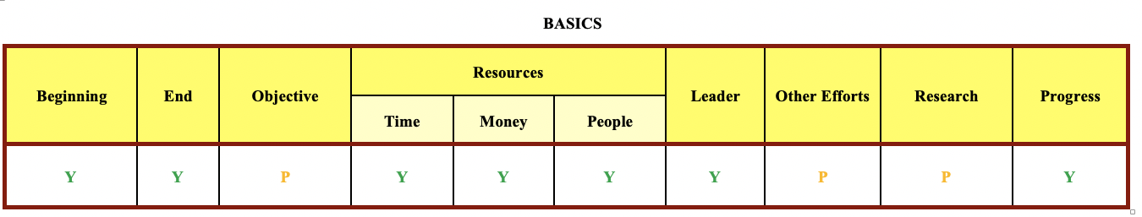
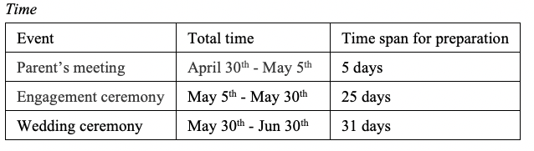
Beginning & End: April 30, 2021 - Jun 30, 2021.
Money: 1,000,000 RMB (143, 000 USD).
People: 16 helpers
Leader: Me

Slide 7
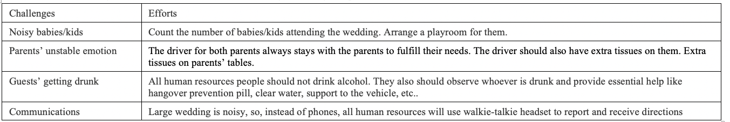
Research:The current version project plan/charter is based on the experience of me, my friends, my friends’ families, and the groom’s peer siblings
Progress:
For all the underlying preparations, I, the Lead Manager will report the progress to the group chat after every item on the Objective checklist is completed.
For all 3 major events, all the helpers and drivers will use walkie-talkie headset to report their status and issues.

Slide 8
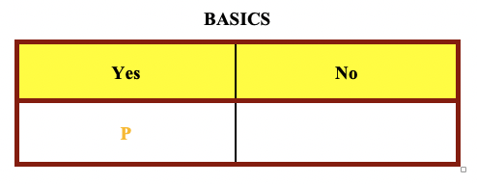
Analysis:
Based on my Research, the values are correct.
Potential problems?
Is my Research sufficient??????
I don’t know. no one knows…….
Possible solutions:
In the planning part
Go through the draft with key stakeholders (new couple and their parents)
Gather their requirements/feedbacks
Make adjustment

Slide 9
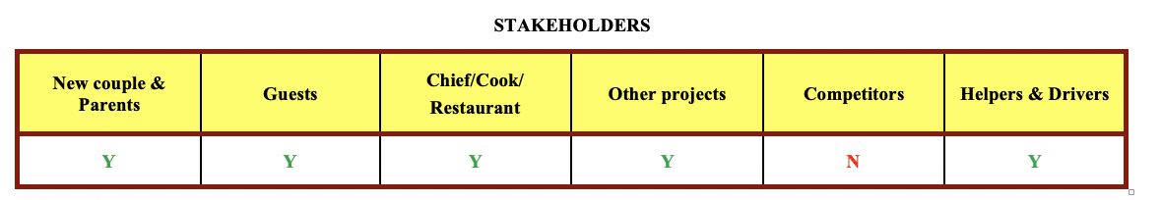
Based on my Research, the values are correct.
Potential problems?
Competitors?
Angry ex?
Possible solutions:
Identify the potential guest that might might hold a grudge against the couple or the family
Helpers as security guards

Slide 10
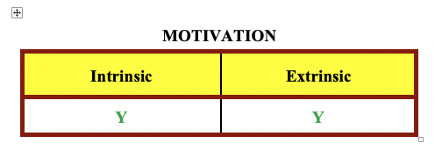
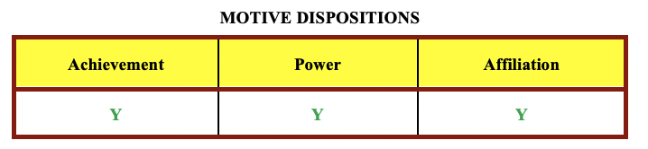
New couple & Parents: Intrinsic, Extrinsic, Achievement (Celebration & Gift Money)
Guests: Intrinsic, Extrinsic, Affiliation (Celebration & Meal)
Chef/Cook/Restaurant: Extrinsic, Achievement (Payment & Marketing)
Helpers & Drivers: Intrinsic, Achievement, Affiliation (Friends)
Leader/Manager: Intrinsic, Achievement, Power, Affiliation (Friends, Apply what I learn to a real project)
Most Values are correct

Slide 11
Pontential problems?
My need for power with all that resources
Possible solution:
In the planning part
Go through the draft with key stakeholders (new couple and their parents)
Gather their requirements/feedbacks
Make adjustment
At all time:
reflect, reflect, reflect……...

Slide 12
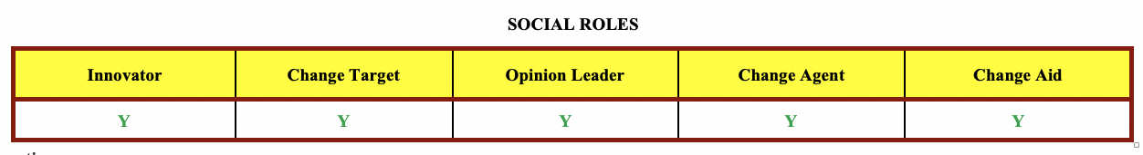
Innovator: The new couple and their parents. (Let’s use this meal plan)
Change Target: Both families and all guests (Meal)
Opinion Leader: New couple and their parents (This meal plan might me a good idea)
Change Agent: Project Manager (me, help contact the restaurant for meal preparation)
Change Aid: Possibly family members or friends (Use similar meal plan)
The values are correct, because the wedding is all about family and I am just there to make sure the wedding demonstrate what they want.
No potential problems.

Slide 13
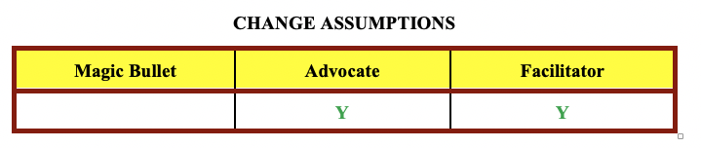
Planning:
Advocate: the new couple and their parents (giving feedback)
Facilitator: Leader/Manager (lead the discussion, throw questions)
Execution:
Advocate: helper & drivers (support the process)
Facilitator: Leader/Manager (answer questions, update current process, give directions)
The values are correct. No potential problems.

Slide 14
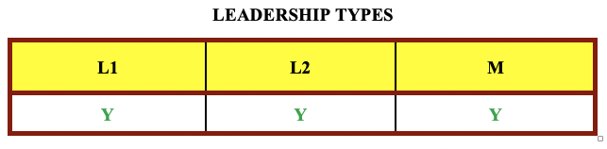
For the whole project, M
Decide how to spend resources
Correct. Focus: optimal utilization of resources, in the world of machine
For the planning, L1
Making the plan and adjust the plan according to the families requirements
Correct. Making plans, negotiating with key stakeholder
For the execution, L2
Communicate with helpers/drivers, give directions
Correct. Make sure everyone knows what to do
No potential questions.

Slide 15
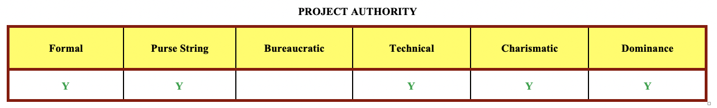
Formal, Pruse String: Leader/Manager (all authorities)
Technical: driver, Chef/cook (Only given requirement)
Charismatic: Leader/Manager (the couple & parents need my “people” skills)
Dominance: Leader/Manager (16 friends willing to come as helper/driver)
Values are correct.
Potential problems:
too much authority on me
Possible solutions:
list to stakeholders feedback on my plan
reflect, reflect, reflect

Slide 16
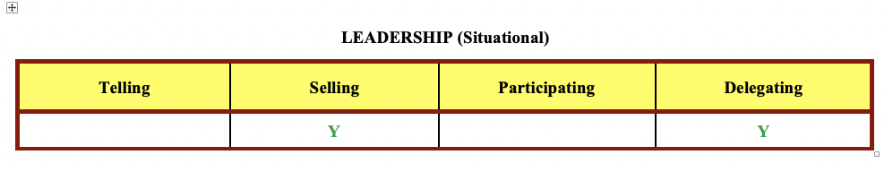
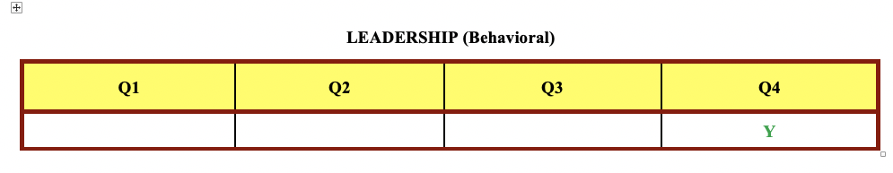
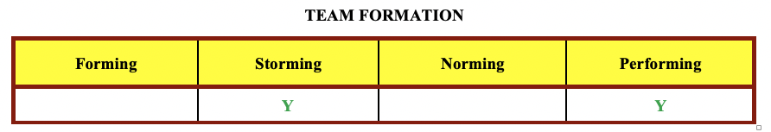
For the planning phrase:
Behavioral, Q4; Situational, Delegating, Norming
I lead the discussion, throw out questions, asking for clarification (challenge, lead)
Mark their requirements and reflect it on the plan (respective, responsive)
Dominant in Control and Warm in Sensitivity, so, Q4
Stakeholders are able and willing to discuss and provide feedback, no instruction needed
High readiness, low task and low relationship support needed, so, Delegating & Performing
For the execution phrase:
Behavioral, Q4; Situational, Selling, Storming
I lead the team, give them updates and help with clarifications
Dominant in Control and Warm in Sensitivity, so, Q4
I only gather them together and did not give specific requirements. They might be confused.
The helper/driver are willing to come help
Unable but willing, so, Selling, Stroming
Hold a meeting, give specific task requirements after the plan is finalized

Slide 17
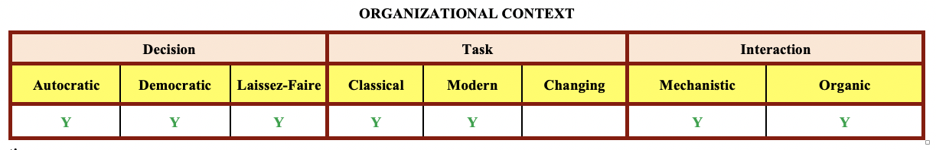
Planning:
Democratic: Mark requirements, and adjust the plan.
Modern: Supply > Demand
Organic: no hierarchical control
Technical part: food preparation and driving,
Laissez-Faire: I only tell them what I want, and they will decide how to do it.
Execution:
Autocratic: Top-down. stick to the plan and follow directions from the leader.
Classical: Demand > Supply
Mechanistic: Every worker knows their tasks and just executes.
Values are correct. No potential problems.

Slide 18
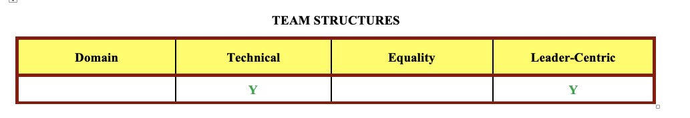
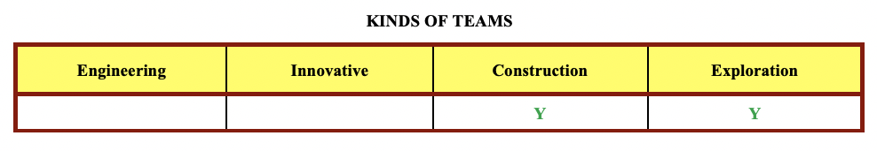
Planning & Preparation, Leader-Centric, Exploration
Gather requirements from stakeholders and make the plan on my own, Leader-Centric
Correct; I manage the whole project at higher level, decide how to spend resources.
Consistent membership, previous plan chanllenged, filter problems until clarity, Exploration
Correct; everyone’s opinion, make the plan clear
Execution, Technical, Construction
Assign the tasks based on their experience and skills, Technical
Correct: Put the helper/driver to the best-fit position (usher, driver, etc.)
Stick to the plan. Construction
Correct: Everything is clear, just execute.
No potential problems.

Slide 19
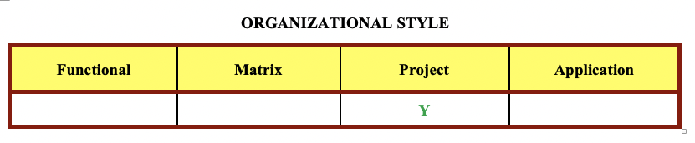
No real orgnization, just teams.
For planning and execution
I am the leader, the one and only.
All authorities, Resource Availability and Budget Control
In this case it might be correct.
Leader/Manager is reliable. Also part of the families.
Might not be correct for other wedding.

Slide 20
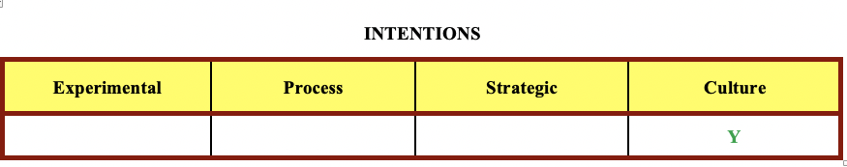
It is a wedding
All about people
Organizational(family) changes
Cannot quantitatively calculate the outcome
The change impact is high, and the Specificity of the outcome is low, so, Culture Intentions
Values are correct. No potential protential problems.

Slide 21
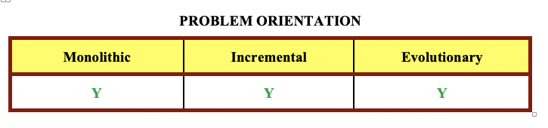
For the whole project, incremental
“Divide and Conquer”, different plans for all 3 major events, each have planning, preparation and execution phrase.
For the planning, Evolutionary
Go though it with the key stakeholders and make adjustment accordingly
A lot of changes and communications
For the execution, Monolithic
Just follow the plan. “Waterfall” style.
Values are correct. No potential problems

Slide 22
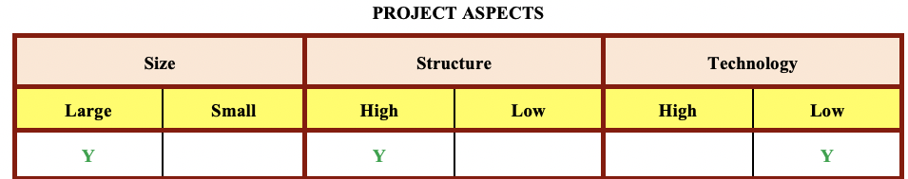
Size: Large
Duration: 2 months
Team: 7 people for preparation, 17 for execution plus some restaurant staff.
Stakeholders: New couple, both families. 400 guests.
Budget: 143, 000 USD
Structure: High
The whole framework, process and most of the requirements are clear, lacking specific requirements
Technology: Low
Not much technology

Slide 23
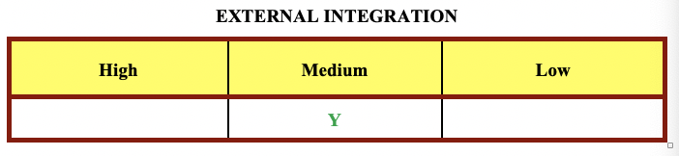
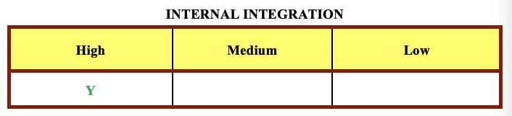
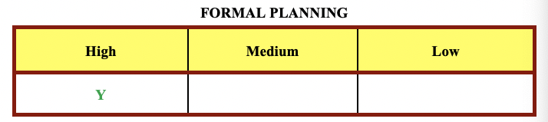
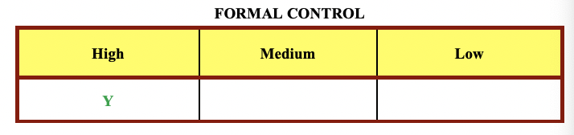
External Integration: Medium
A lot of booking/ordering; outsource
Internal Integration: High
A lot of communication inside the family
Formal Planning: High
A lot of meetings/discussion on the planning, draft/redraft
Formal Control: High
Preparation: Report progress after every move.
Execution: walkie-talkie head set to give instruction, update/report status

Slide 24
 | Size | Structure | Tech | Ex-Integ | In-Integ | Formal Plan | Formal Plan
Current | Large | High | Low | Medium | High | High | High
Should | Large | High | Low | Low | Medium | High | High
Relative/Gradable terms
Making some calls to book the hotels/restaurants and alcohol beverages are not exactly a Medium External Integration.
Asking key stakeholders to participate in only the planning phrase but not the execution phrase is not exactly a High Internal Integration.
All values are correct. No potential problems.

Slide 25
Summary
Basics
Most important: Research. determine project specification and correct ways to handle the project.
Conducting an adequate and sufficient Research is difficult.
Fulfill the key Stakeholders requirements in a wedding project
Communicate with the key stakeholders, acquire their requirements and adjust my plan accordingly.
Stakeholders & Motivation & Motive Disposition & Social roles & Change Assumptions
“What are the stakeholders, what do they want and what influence they have.
For the key stakeholders, Motives are having a dream wedding.
Making my plan with the key stakeholders. Manage the project not producing “new” ideas on my own.
Leadership types & Project Authority & Leadership (Behavioral) & Organizational Style & Leadership (Situational) & Organizational Context & Team Structures & Kind of Teams & Team Formation
“Teams, Team Member and Leadership”
Planning: lead the discussion. The plan comes with collective effort.
Execution: make sure the plan is strictly followed.
I have a good team and my managing style as a lead is correct
Intentions & Problem Orientation & Project Aspects & Internal/External Integration & Formal Planning/Control
“How to approach the project”
Planning: draft and adjust the plan; Execution: execute the plan
High Planning at the planning phrase and High Control in the execution phrase.

Slide 26
My opinions: Promising project!
Questions?
Reference:
Class slides/material/textbook of SP2021.T54.PRJM.524.01
All the terms and methods for identifying and evaluating parameters directly come from the slides.

